Slide 1
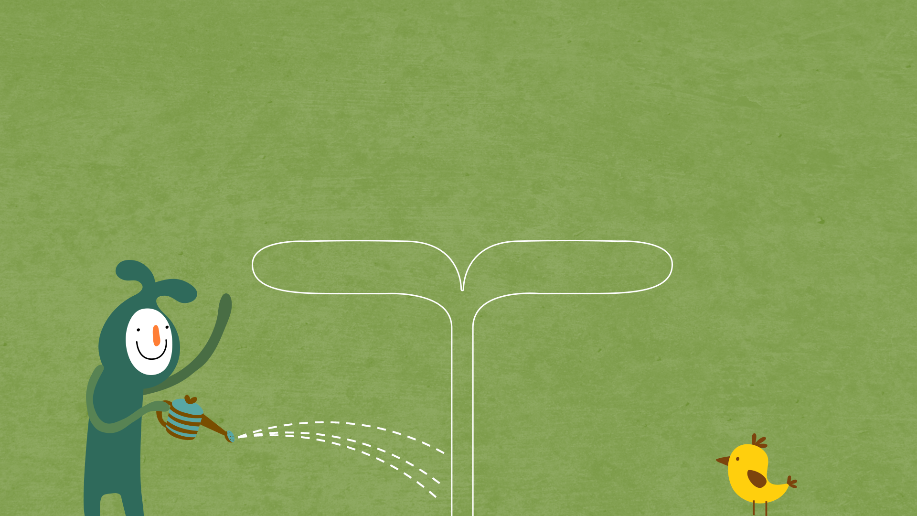

22년 삼성 AI 전문가과정
6월 7일 화요일 3교시
장병탁
인공지능
3차시 : Problem-Solving Agents
서울대학교 컴퓨터공학부
담당 교수: 장병탁
Seoul National University
Byoung-Tak Zhang

Slide 2
Lecture Overview
인공지능
3차시 : Problem-Solving Agents
서울대학교 컴퓨터공학부
담당 교수: 장병탁
Seoul National University
Byoung-Tak Zhang

Slide 3
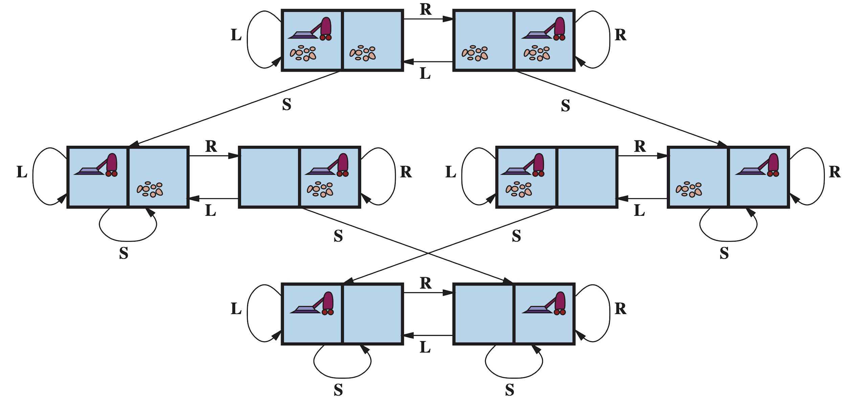
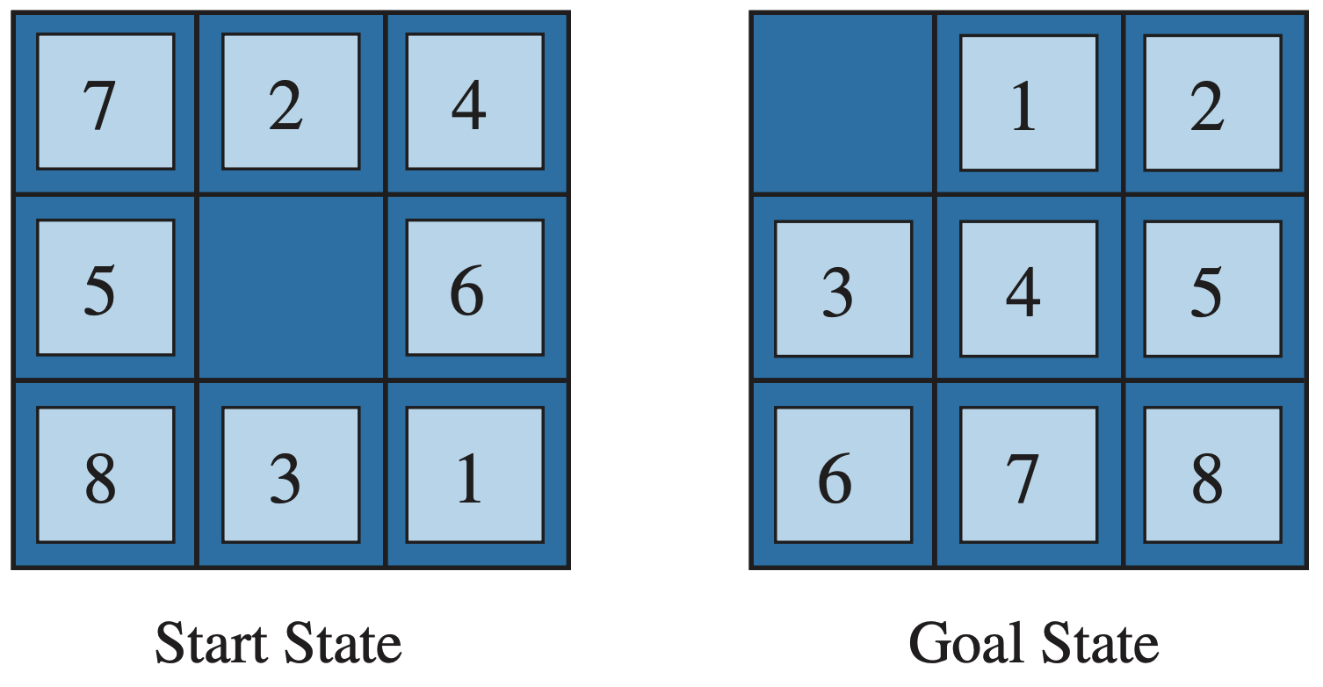
Lecture 3. Problem-Solving Agents
Problem-Solving Agents
What are the Problem-Solving Agents?
Examples of Problems, Goals, Elements
Searching for Solutions
Tree search algorithms
Uninformed Search Strategies
Breadth-first search, Uniform-cost search, Depth-first search, Depth-limited search, Iterative-deepening search
Informed Search Strategies
Greedy Search, A* Search
Heuristic Functions
The 8-puzzle, Relaxed problems
Example:
State-space graph for the two-cell vacuum world
Example:
A typical instance of the 8-puzzle

Slide 4
Problem-Solving Agents
Reflex agents
Goal-based agents
Consider future actions and the desirability of their outcomes
Problem-solving agents (Chapter 3)
Atomic representation (of states)
Planning agents (Chapter 11)
Factored or structured representation
Problem-solving agents (this lecture)
Problems, solutions, search algorithms
Uninformed search algorithms
Informed search algorithms

Slide 5
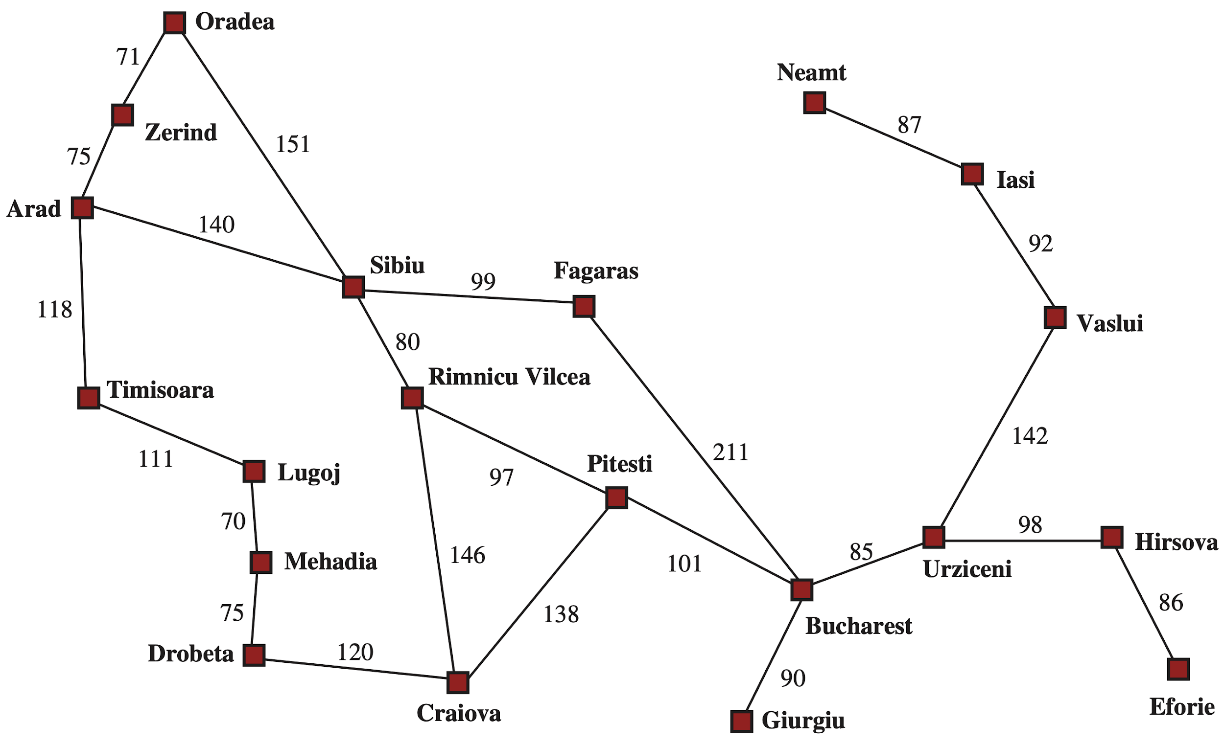
Problem Solving as Search in State Space: Touring (Driving)
Start State
Goal: be in Bucharest
Problem formulation:
states = various cities
actions = drive between cities
Goal-based Agent
Goal State
Touring (Driving)
<출처> Stuart J. Russell and Peter Norvig (2021). Artificial Intelligence: A Modern Approach (4th Edition). Pearson

Slide 6
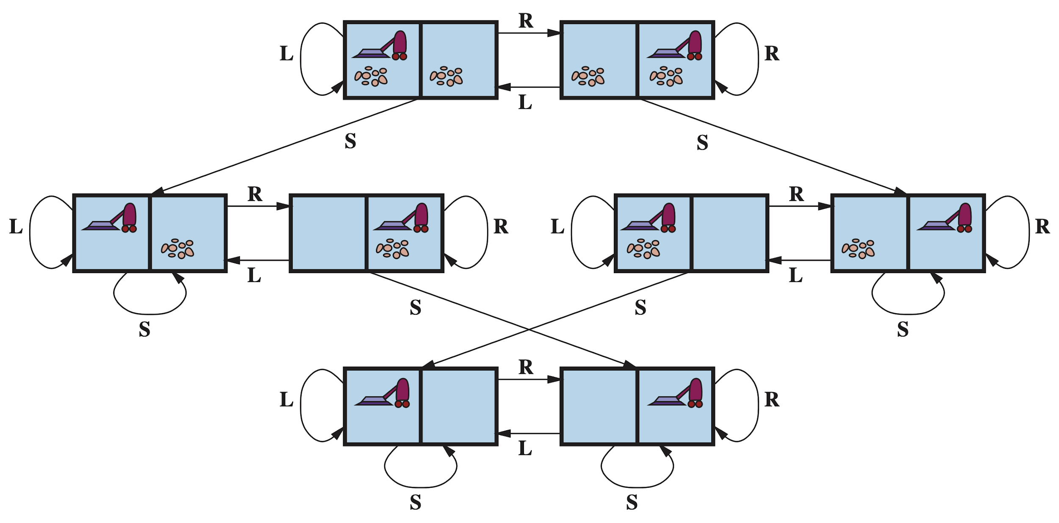
Problem-Solving Agent: Vacuum Cleaner Robot
Start State
Goal: all rooms clean
Problem formulation:
States: Boolean dirt and robot location
Actions: Left, Right, Suck
Goal State(s)
Vacuuming
<출처> Stuart J. Russell and Peter Norvig (2021). Artificial Intelligence: A Modern Approach (4th Edition). Pearson

Slide 7
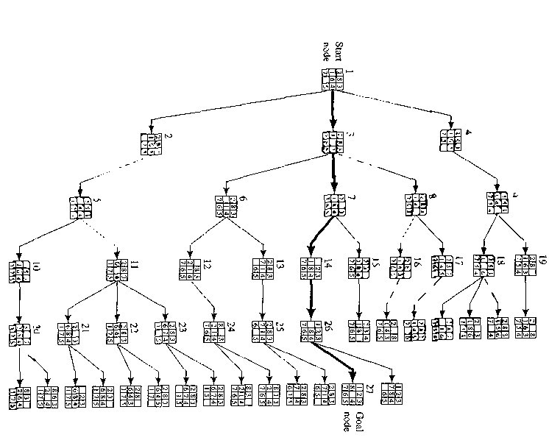
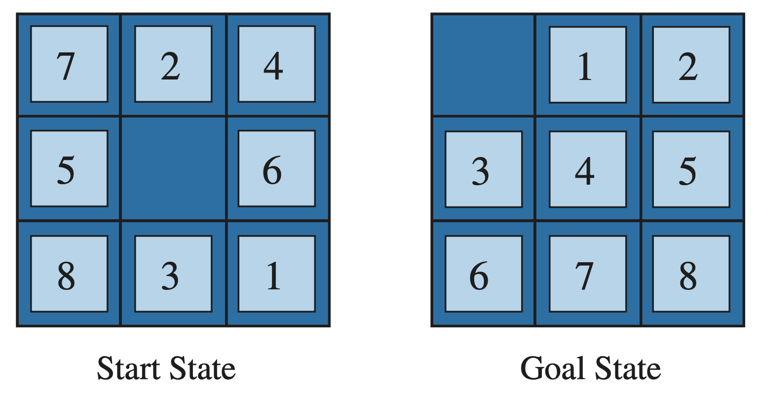
Problem Solving as Search in State Space
Start State
Puzzle Solving
Goal State
<출처> Stuart J. Russell and Peter Norvig (2021). Artificial Intelligence: A Modern Approach (4th Edition). Pearson

Slide 8
Lecture 3. Problem-Solving Agents
Problem-Solving Agents
What are the Problem-Solving Agents?
Examples of Problems, Goals, Elements
Searching for Solutions
Tree search algorithms
Uninformed Search Strategies
Breadth-first search, Uniform-cost search, Depth-first search, Depth-limited search, Iterative-deepening search
Informed Search Strategies
Greedy Search, A* Search
Heuristic Functions
The 8-puzzle, Relaxed problems
Example:
State-space graph for the two-cell vacuum world
Example:
A typical instance of the 8-puzzle

Slide 9
Outline (Lecture 3)
3.1 Problem-Solving Agents ……………………………
3.2 Example Problems ………………………………….
3.3 Searching for Solutions ……………………………..
3.4 Uninformed Search Strategies ……………………...
3.5 Informed Search Strategies …………………………
3.6 Heuristic Functions …………………………………
Summary ………………………………………………..
10
15
20
25
37
45
49

Slide 10
3.1. Problem-Solving Agents

Slide 11
3.1 Problem-Solving Agents (1/4)
Here we consider the environment:
Observable: The agent always knows the current state
Known: The agent knows which states are reached by each action
Deterministic: Each action has exactly one outcome
In this environment, the solution to any problem is a fixed sequence of actions. The agent ignores its percepts when choosing an action because it knows in advance what they will be. The agent is an open-loop system (“eyes closed”).
Problem solving as search in state space
Goal formulation: A goal is a set of world states to be reached.
Problem formulation: The process of deciding what actions and states should be considered
Search is the process of looking for a sequence of actions that reaches the goal in the state space.
Well-defined problems and solutions
Problem = <initial state, actions, transition model, goal test, path cost>
A solution to a problem is an action sequence that leads from the initial state to a goal state.

Slide 12
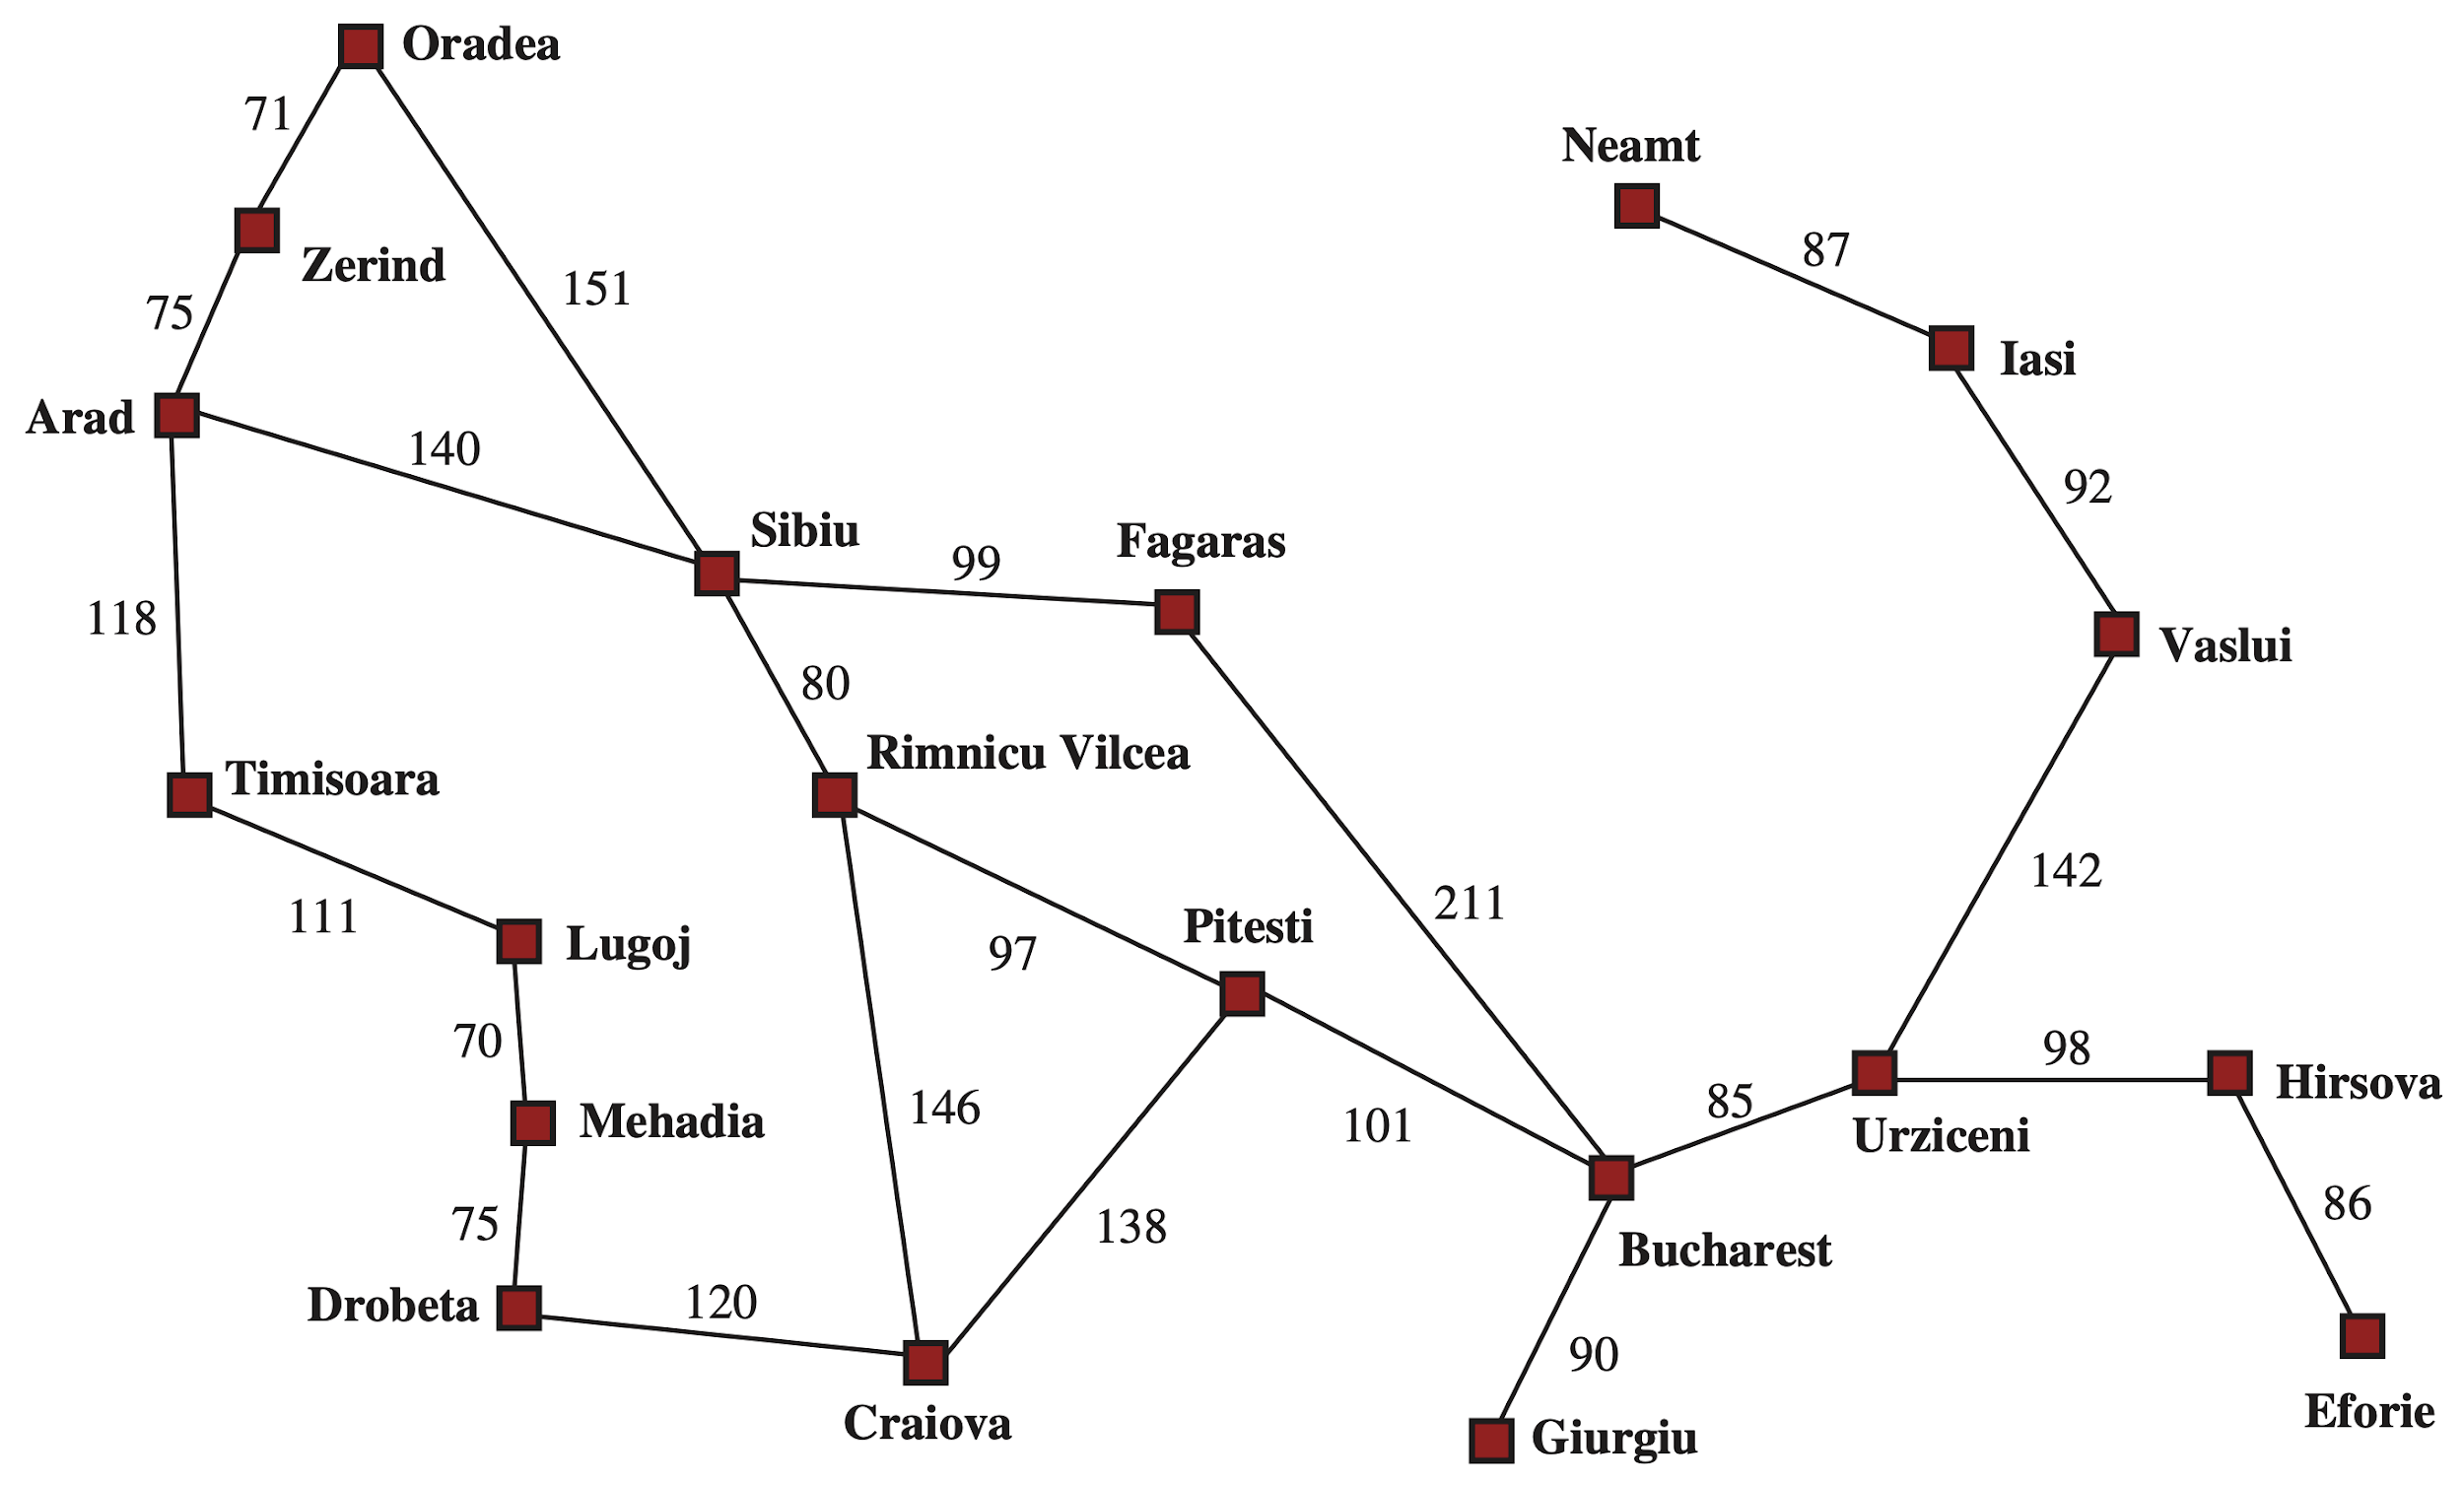
3.1 Problem-Solving Agents (2/4)
Example: Romania
Goal: be in Bucharest
Problem formulation:
states = various cities
actions = drive between cities
<출처> Stuart J. Russell and Peter Norvig (2021). Artificial Intelligence: A Modern Approach (4th Edition). Pearson

Slide 13
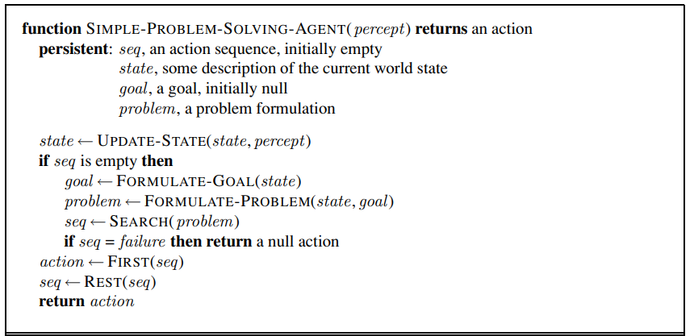
3.1 Problem-Solving Agents (3/4)
Simple form of problem-solving agents
Percept
State
Action
Goal

Slide 14
3.1 Problem-Solving Agents (4/4)
Problem types
Deterministic,
Fully observable ⇒ Single-state
Non-observable ⇒ Conformant problem
(sensorless)
Nondeterministic and/or
Partially observable ⇒ Contingency problem
Unknown state space ⇒ Exploration problem
(online)
This lecture
Later

Slide 15
3.2. Example Problems

Slide 16
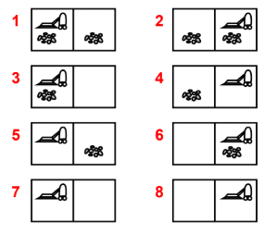
3.2 Example Problems (1/4)
Example: vacuum world
States: Boolean dirt and robot location
Actions: Left, Right, Suck
Transition model: (next page)
Goal test: no dirt
Path cost: 1 per action

Slide 17
3.2 Example Problems (2/4)
Vacuum world
Single-state
start in 5
[R, S]
Conformant
start in {1,2,3,4,5,6,7,8}
[R, S, L, S]
Contingency
start in 5
Murphy’s Law: [S] can make clean square dirty
[R, if dirt then S]
State 5
<출처> Stuart J. Russell and Peter Norvig (2021). Artificial Intelligence: A Modern Approach (4th Edition). Pearson

Slide 18
3.2 Example Problems (3/4)
Example: The 8-puzzle (NP-hard)
States: integer location of tiles
Actions: move blank tile Left, Right, Up, Down
Transition model:
Goal test: goal state
Path cost: 1 per action
<출처> Stuart J. Russell and Peter Norvig (2021). Artificial Intelligence: A Modern Approach (4th Edition). Pearson

Slide 19
3.1 Problem-Solving Agents (4/4)
Start State
Puzzle Solving
Goal State
<출처> Stuart J. Russell and Peter Norvig (2021). Artificial Intelligence: A Modern Approach (4th Edition). Pearson

Slide 20
3.3. Searching for Solutions

Slide 21
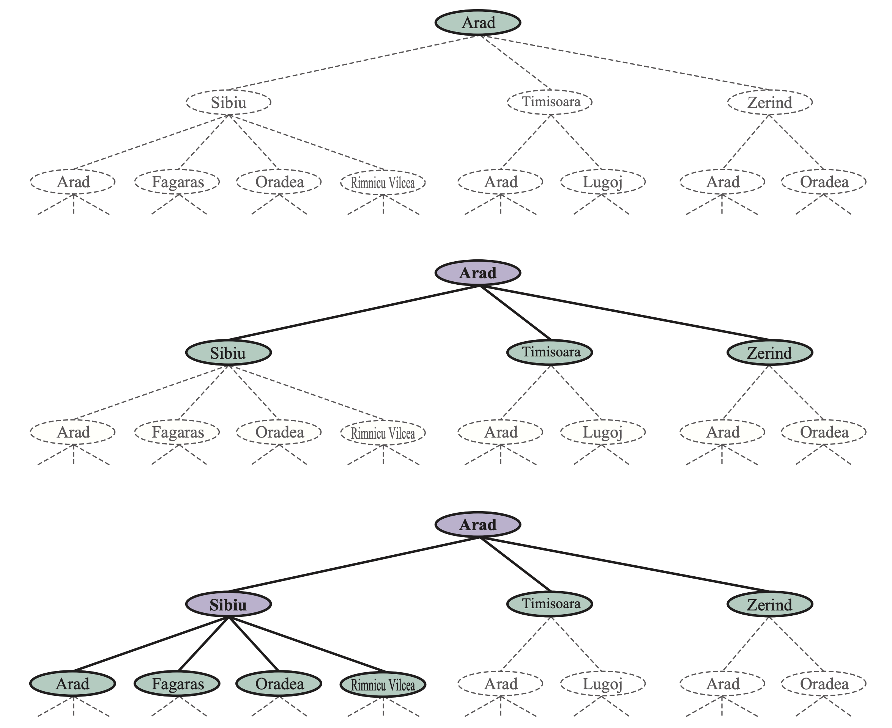
3.3 Searching for Solutions (1/4)
Partial search trees for finding a route from Arad to Bucharest
<출처> Stuart J. Russell and Peter Norvig (2021). Artificial Intelligence: A Modern Approach (4th Edition). Pearson

Slide 22
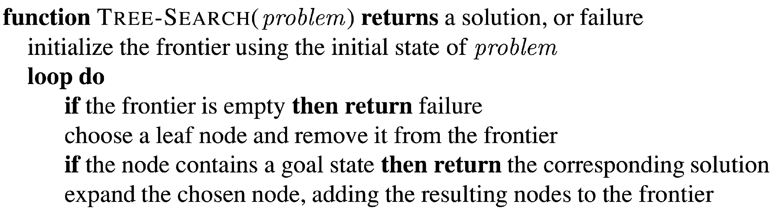
3.3 Searching for Solutions (2/4)
Tree search algorithms
Basic Idea: offline, simulated exploration of state space by generating successors of already-explored states
frontier
<출처> Stuart J. Russell and Peter Norvig (2021). Artificial Intelligence: A Modern Approach (4th Edition). Pearson

Slide 23
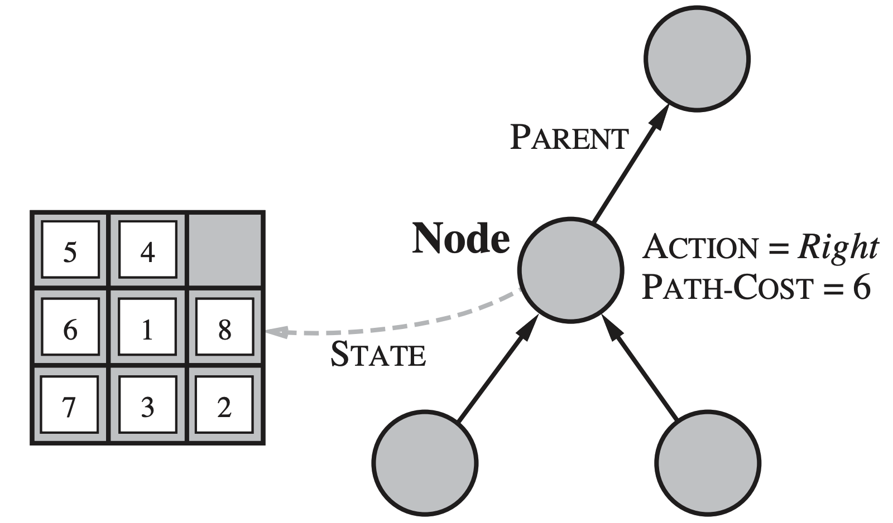
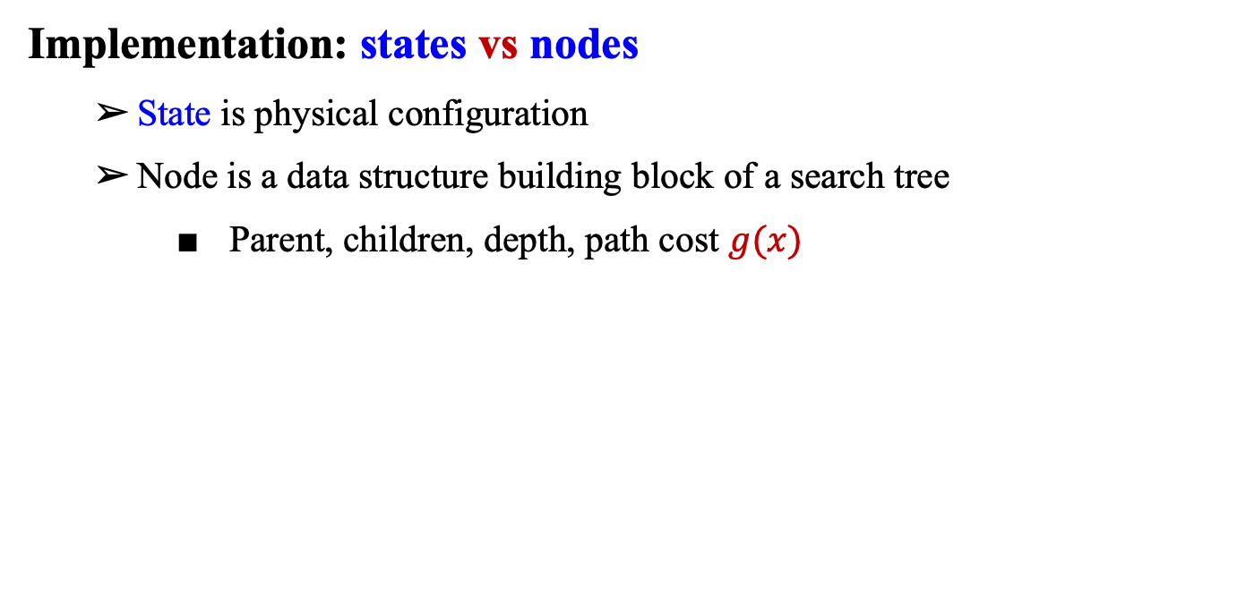
3.3 Searching for Solutions (3/4)
Implementation: states vs nodes
State is physical configuration
Node is a data structure building block of a search tree
Parent, children, depth, path cost $g(x)$
<출처> Stuart J. Russell and Peter Norvig (2021). Artificial Intelligence: A Modern Approach (4th Edition). Pearson

Slide 24
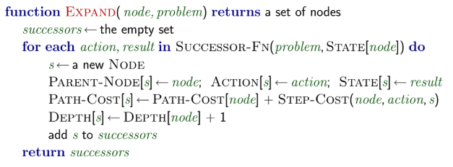
3.3 Searching for Solutions (4/4)
Implementation: EXPAND
The Expand function creates new nodes, filling in the various fields
Use successor of the problem to create corresponding states

Slide 25
3.4. Uninformed Search Strategies

Slide 26
3.4 Uninformed Search Strategies (1/11)
Evaluating for search strategies
Strategy is defined by picking the order of node expansion
Strategies are evaluated along the following metrics:
Completeness: Guarantee to find a solution if one exists
Optimality: Guarantee to find a minimum-cost path
Time complexity: How many nodes to expand to find a solution
Space complexity: How many nodes to keep to perform search

Slide 27
3.4 Uninformed Search Strategies (2/11)
2) Uninformed search strategies
Uninformed strategies use only the information available in the problem definition
Breadth-first search
Uniform-cost search
Depth-first search
Depth-limited search
Iterative-deepening search

Slide 28
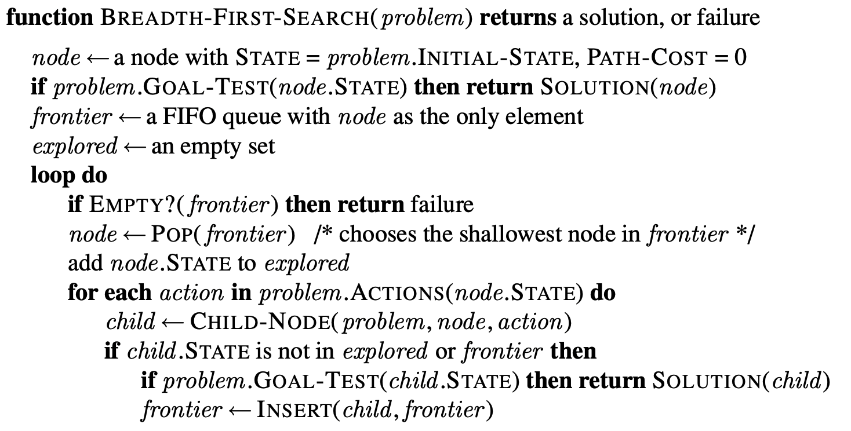
3.4 Uninformed Search Strategies (3/11)
I. Breadth-first search
Expand shallowest unexpanded node
Implement: fringe is a FIFO queue, i.e., new successors go at end

Slide 29
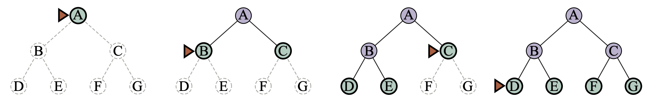
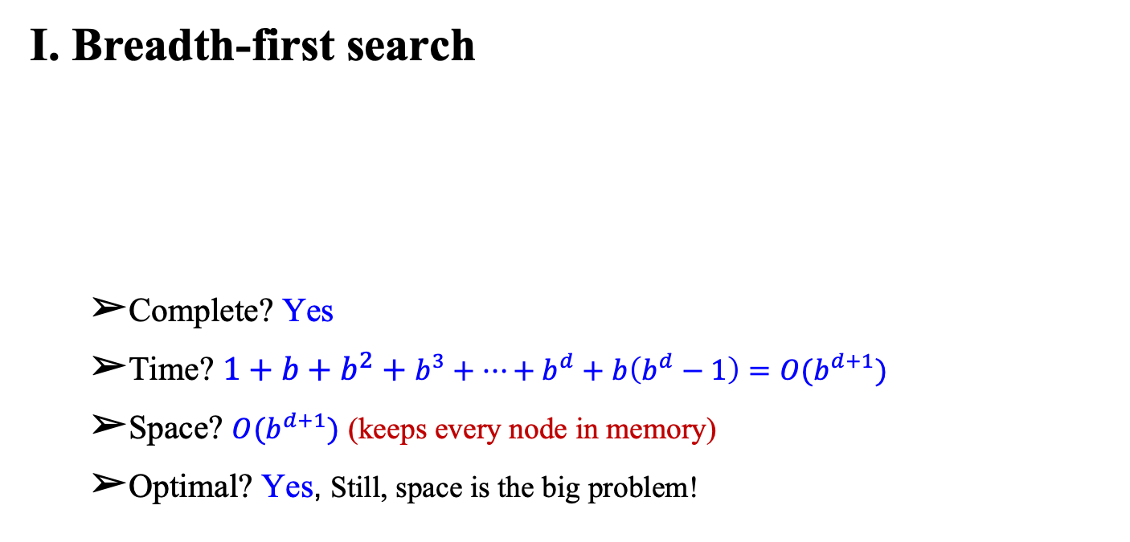
3.4 Uninformed Search Strategies (4/11)
I. Breadth-first search
Complete? Yes
Time? $1+b+b^{2}+b^{3}+…+b^{d}+b\left(b^{d}−1\right)=O(b^{d+1})$
Space? $O(b^{d+1})$ (keeps every node in memory)
Optimal? Yes, Still, space is the big problem!
<출처> Stuart J. Russell and Peter Norvig (2021). Artificial Intelligence: A Modern Approach (4th Edition). Pearson

Slide 30
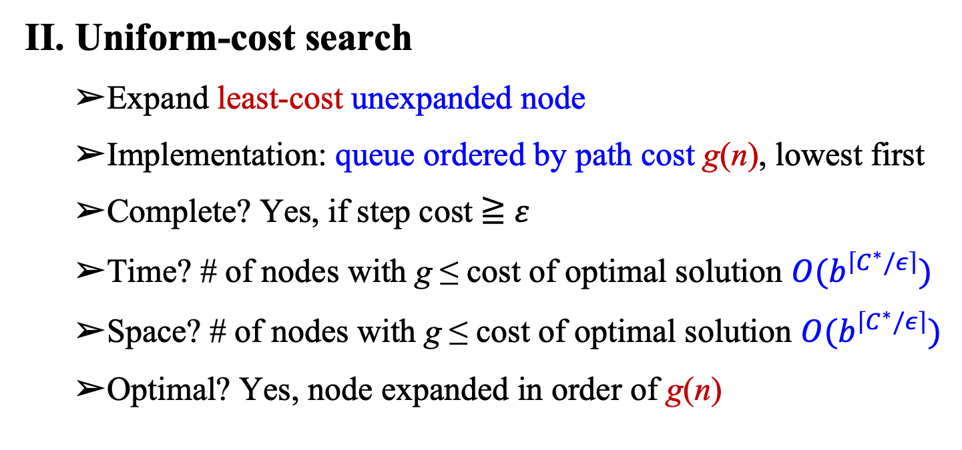
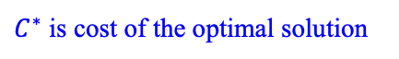
3.4 Uninformed Search Strategies (5/11)
II. Uniform-cost search
Expand least-cost unexpanded node
Implementation: queue ordered by path cost g(n), lowest first
Complete? Yes, if step cost ≧ $ε$
Time? # of nodes with g ≤ cost of optimal solution $O(b^{\left\lceil C^{∗}/ε\right\rceil })$
Space? # of nodes with g ≤ cost of optimal solution $O(b^{\left\lceil C^{∗}/ε\right\rceil })$
Optimal? Yes, node expanded in order of g(n)
$C^{∗}$ is cost of the optimal solution

Slide 31
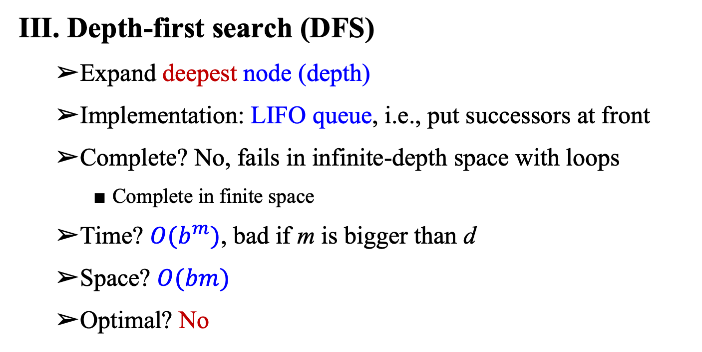
3.4 Uninformed Search Strategies (6/11)
III. Depth-first search (DFS)
Expand deepest node (depth)
Implementation: LIFO queue, i.e., put successors at front
Complete? No, fails in infinite-depth space with loops
Complete in finite space
Time? $O(b^{m})$, bad if m is bigger than d
Space? $O(bm)$
Optimal? No

Slide 32
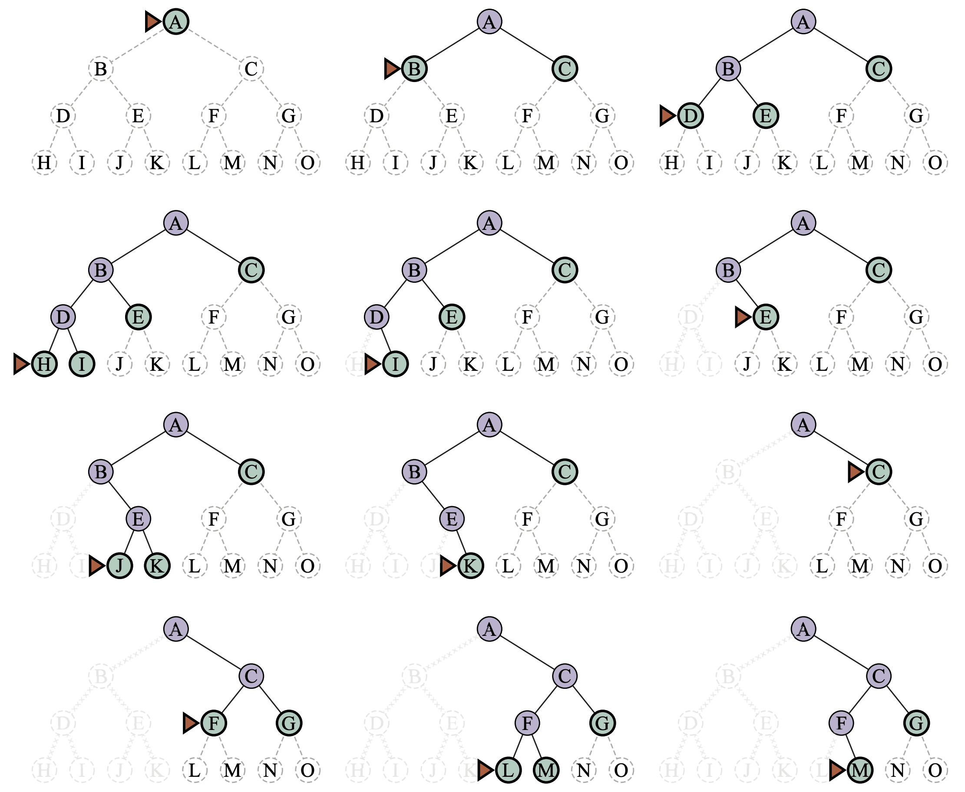
3.4 Uninformed Search Strategies (7/11)
Depth-first search
<출처> Stuart J. Russell and Peter Norvig (2021). Artificial Intelligence: A Modern Approach (4th Edition). Pearson

Slide 33
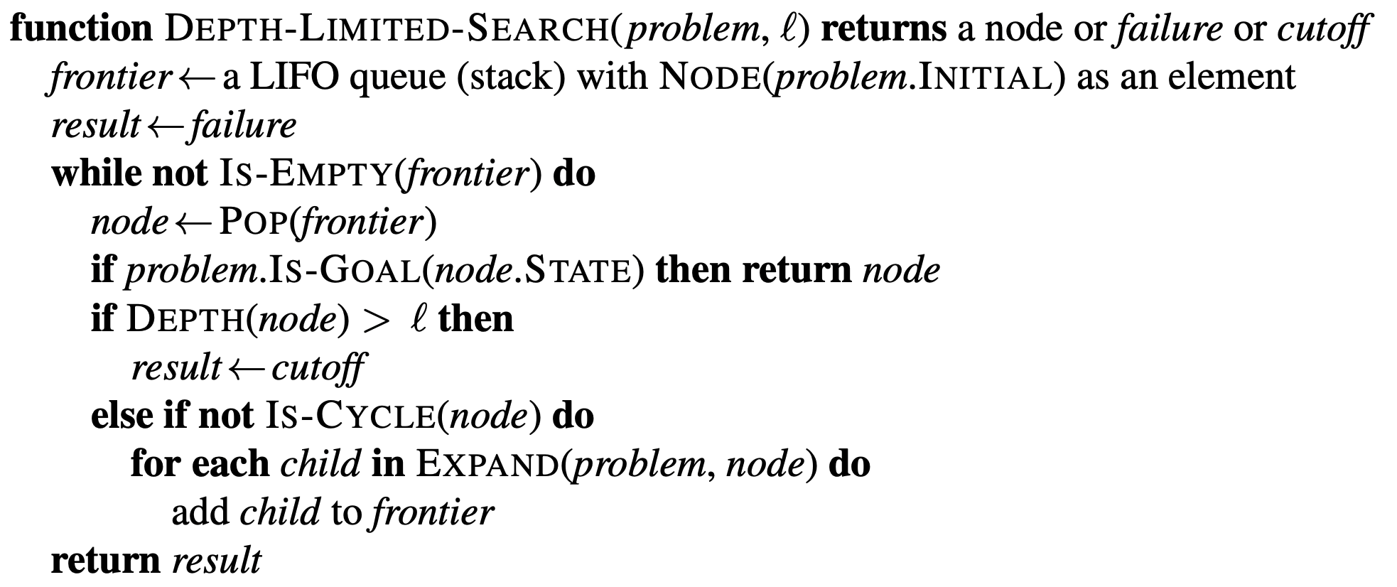
3.4 Uninformed Search Strategies (8/11)
IV. Depth-limited search (DLS)
Depth-first search with depth limit l
Node at depth l, have no successor
<출처> Stuart J. Russell and Peter Norvig (2021). Artificial Intelligence: A Modern Approach (4th Edition). Pearson

Slide 34
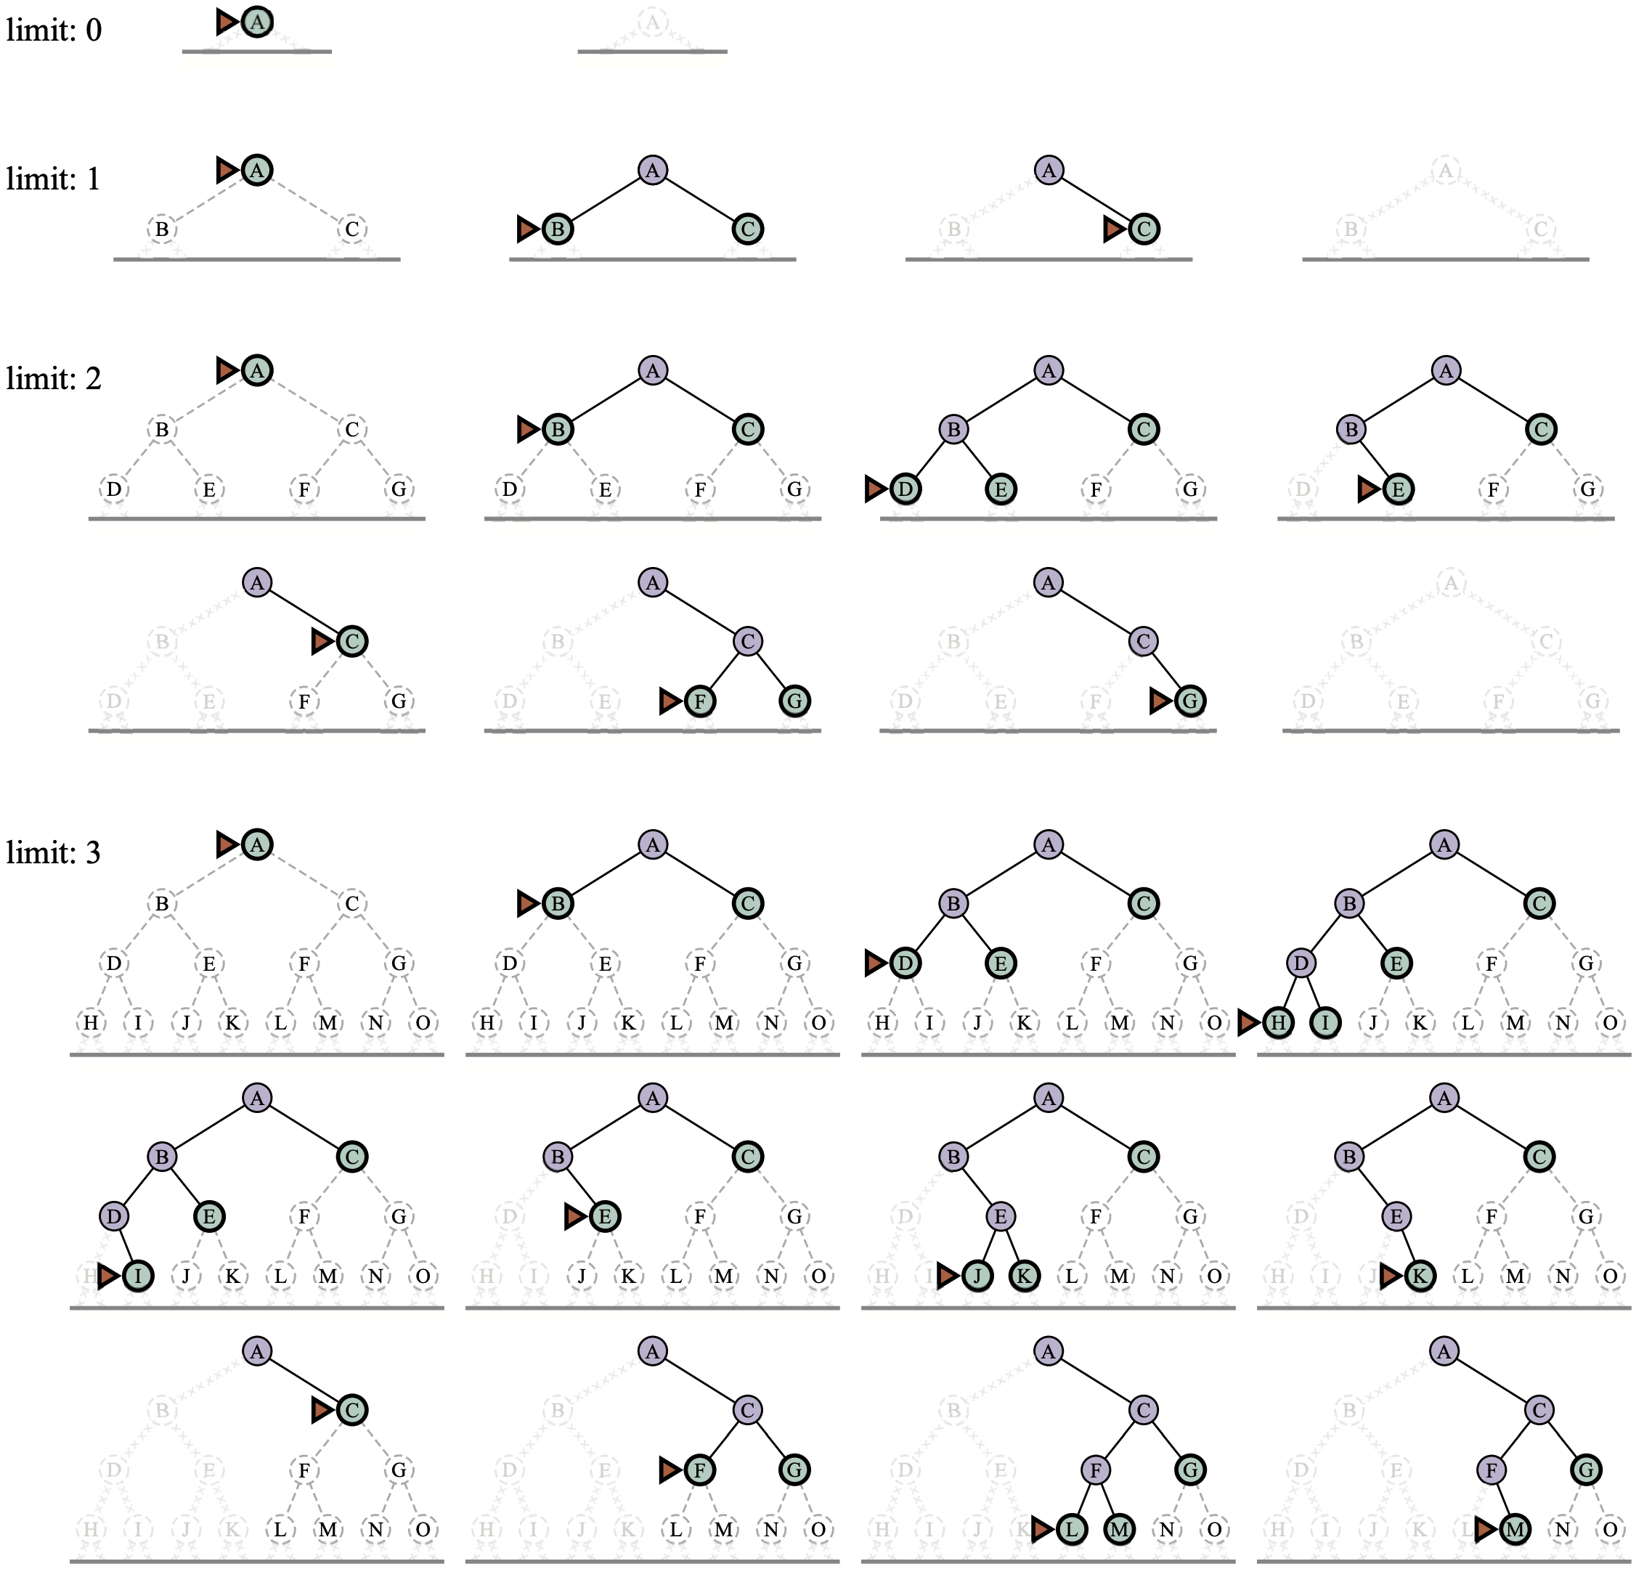
3.4 Uninformed Search Strategies (9/11)
V. Iterative deepening search
General strategy often used in combination with DFS and find the best depth limit
<출처> Stuart J. Russell and Peter Norvig (2021). Artificial Intelligence: A Modern Approach (4th Edition). Pearson

Slide 35
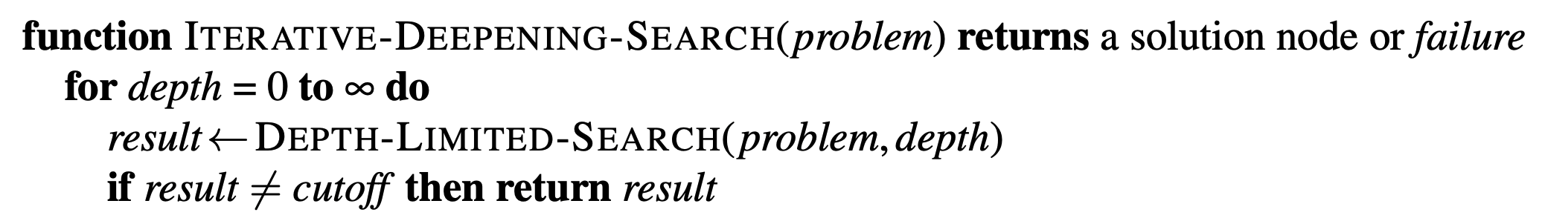
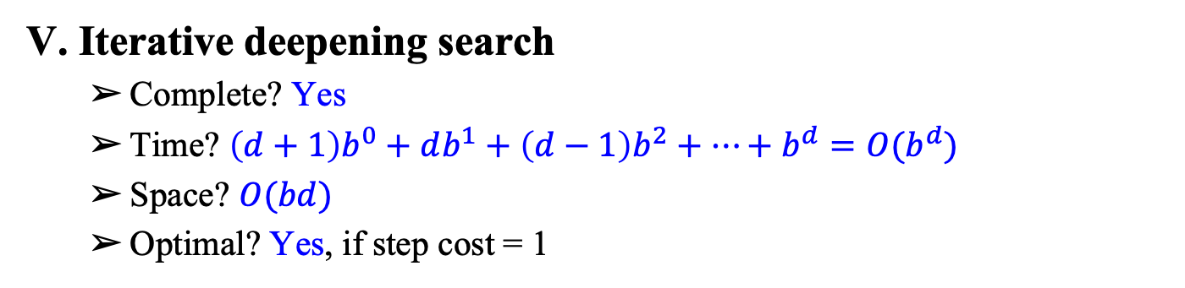
3.4 Uninformed Search Strategies (10/11)
V. Iterative deepening search
Complete? Yes
Time? $\left(d+1\right)b^{0}+db^{1}+\left(d−1\right)b^{2}+…+b^{d}=O(b^{d})$
Space? $O(bd)$
Optimal? Yes, if step cost = 1
<출처> Stuart J. Russell and Peter Norvig (2021). Artificial Intelligence: A Modern Approach (4th Edition). Pearson

Slide 36
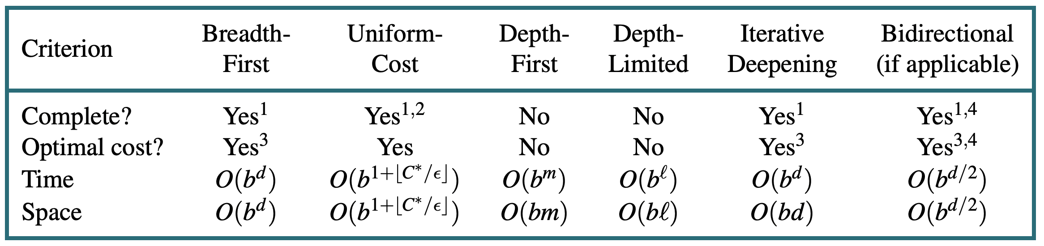
3.4 Uninformed Search Strategies (11/11)
Summary of algorithms
<출처> Stuart J. Russell and Peter Norvig (2021). Artificial Intelligence: A Modern Approach (4th Edition). Pearson

Slide 37
3.5. Informed Search Strategies

Slide 38
3.5 Informed Search Strategies (1/7)
Best-first search
Idea: use an evaluation function for each node
Expand more desirable unexpanded node
Implement: queue sorted in decreasing order of desirability
Special cases:
Greedy search
A* search

Slide 39
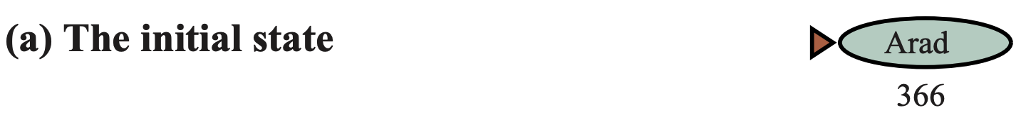
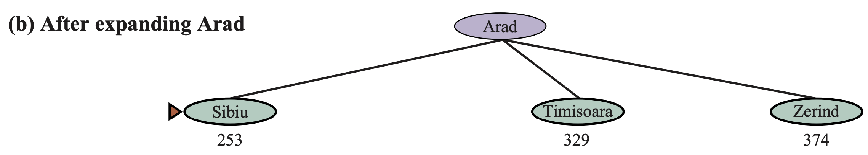
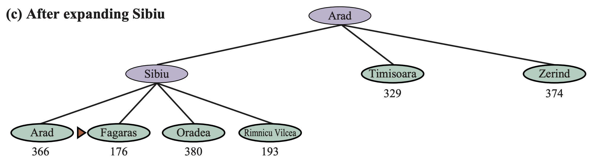
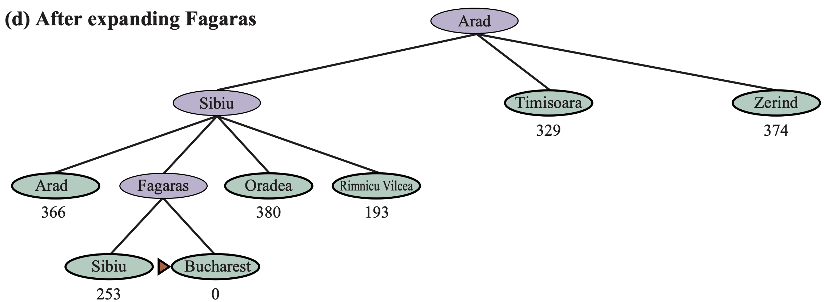
3.5 Informed Search Strategies (2/7)
Greedy search
Evaluation function h(n)
Estimate of cost from n to the closest goal
Greedy search expands the node that appears to be closest to goal
<출처> Stuart J. Russell and Peter Norvig (2021). Artificial Intelligence: A Modern Approach (4th Edition). Pearson

Slide 40
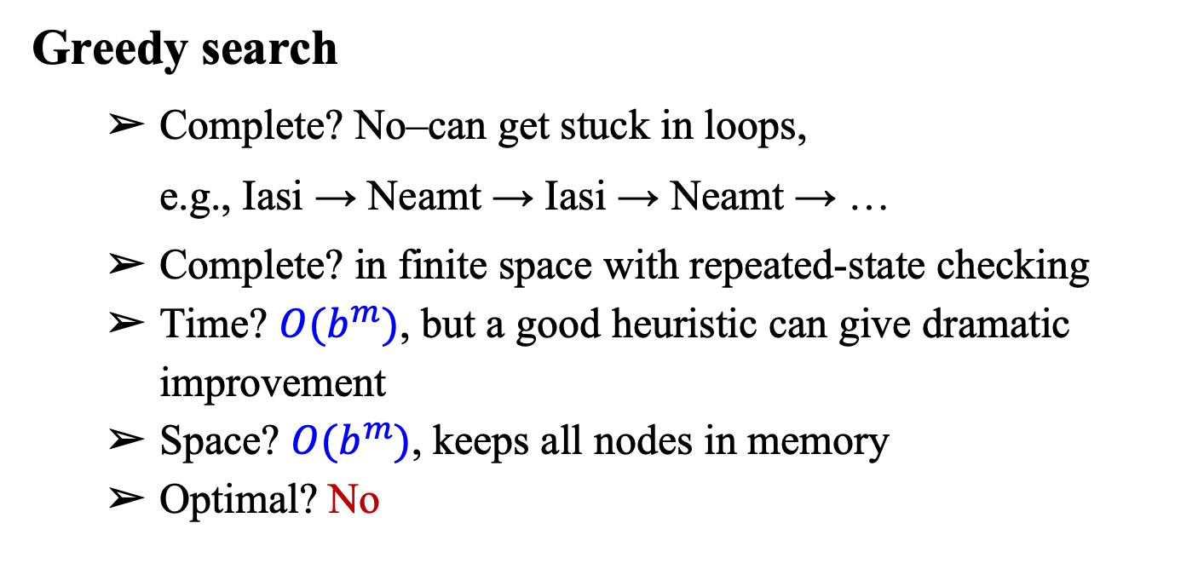
3.5 Informed Search Strategies (3/7)
Greedy search
Complete? No–can get stuck in loops,
e.g., Iasi → Neamt → Iasi → Neamt → …
Complete? in finite space with repeated-state checking
Time? $O(b^{m})$, but a good heuristic can give dramatic improvement
Space? $O(b^{m})$, keeps all nodes in memory
Optimal? No

Slide 41
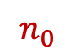
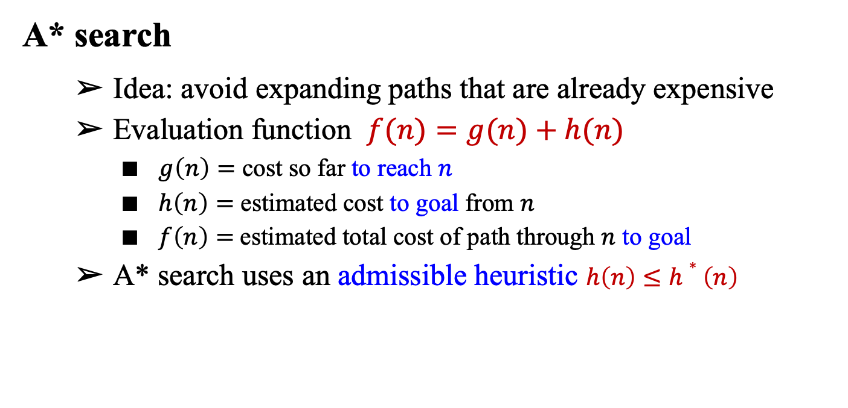
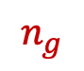
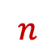
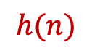
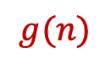
3.5 Informed Search Strategies (4/7)
A* search
Idea: avoid expanding paths that are already expensive
Evaluation function $f(n)=g(n)+h(n)$
$g\left(n\right)=$ cost so far to reach $n$
$h\left(n\right)=$ estimated cost to goal from $n$
$f\left(n\right)=$estimated total cost of path through $n$ to goal
A* search uses an admissible heuristic $h\left(n\right)≤h∗\left(n\right)$
$$g(n)$$
$$h(n)$$
Start
$$n_{0}$$
$$n$$
$$n_{g}$$
Goal

Slide 42
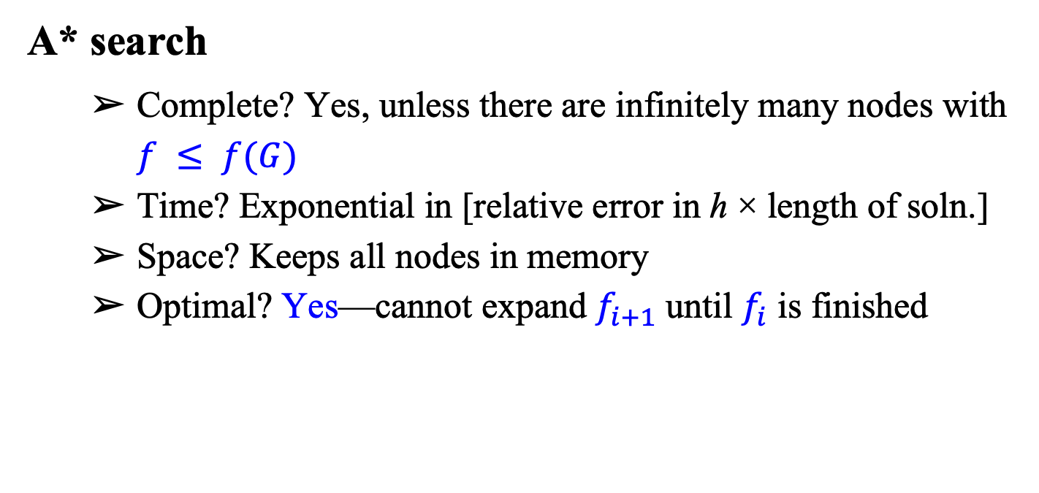
3.5 Informed Search Strategies (5/7)
A* search
Complete? Yes, unless there are infinitely many nodes with $f ≤ f(G)$
Time? Exponential in [relative error in h × length of soln.]
Space? Keeps all nodes in memory
Optimal? Yes—cannot expand $f_{i+1}$ until $f_{i}$ is finished

Slide 43
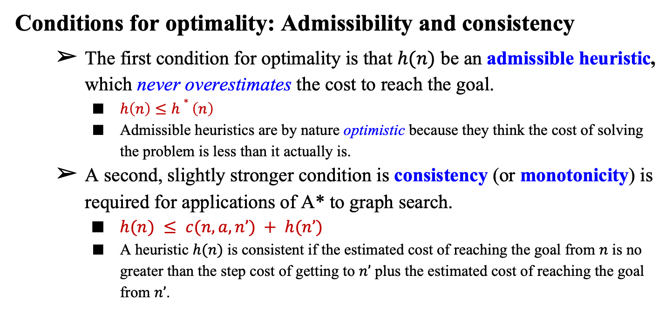
3.5 Informed Search Strategies (6/7)
Conditions for optimality: Admissibility and consistency
The first condition for optimality is that $h(n)$ be an admissible heuristic, which never overestimates the cost to reach the goal.
$h\left(n\right)≤h∗\left(n\right)$
Admissible heuristics are by nature optimistic because they think the cost of solving the problem is less than it actually is.
A second, slightly stronger condition is consistency (or monotonicity) is required for applications of A* to graph search.
$h(n) ≤ c(n, a, n’) + h(n’)$
A heuristic $h(n)$ is consistent if the estimated cost of reaching the goal from $n$ is no greater than the step cost of getting to $n’$ plus the estimated cost of reaching the goal from $n’$.

Slide 44

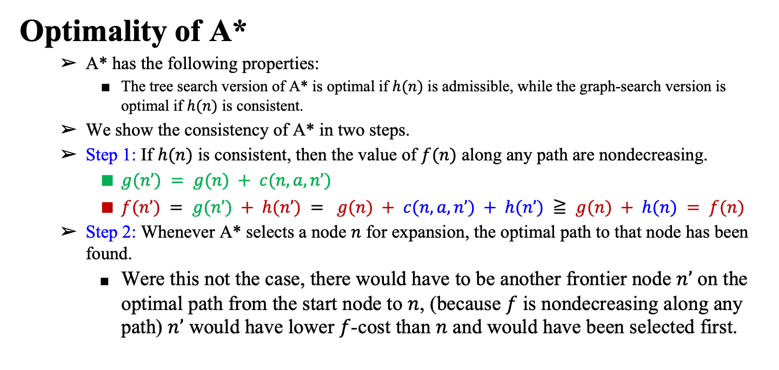
3.5 Informed Search Strategies (7/7)
Optimality of A*
A* has the following properties:
The tree search version of A* is optimal if $h(n)$ is admissible, while the graph-search version is optimal if $h(n)$ is consistent.
We show the consistency of A* in two steps.
Step 1: If $h(n)$ is consistent, then the value of $f(n)$ along any path are nondecreasing.
$g(n’) = g(n) + c(n, a, n’)$
$f(n’) = g(n’) + h(n’) = g(n) + c(n, a, n’) + h(n’) ≧ g(n) + h(n) = f(n)$
Step 2: Whenever A* selects a node $n$ for expansion, the optimal path to that node has been found.
Were this not the case, there would have to be another frontier node $n’$ on the optimal path from the start node to $n$, (because $f$ is nondecreasing along any path) $n’$ would have lower $f$-cost than $n$ and would have been selected first.

Slide 45
3.6. Heuristic Functions

Slide 46
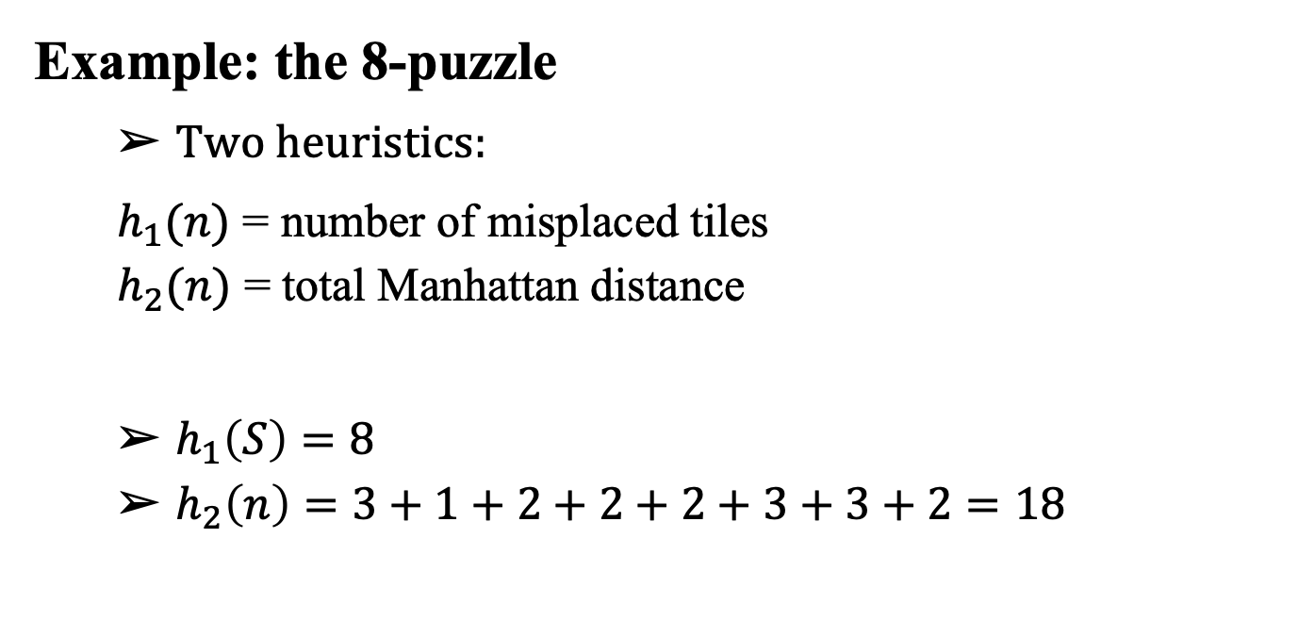
3.6 Heuristic Functions (1/3)
Example: the 8-puzzle
Two heuristics:
$h_{1}(n)$ = number of misplaced tiles
$h_{2}(n)$ = total Manhattan distance
$h_{1}\left(S\right)=8$
$h_{2}\left(n\right)=3+1+2+2+2+3+3+2=18$
<출처> Stuart J. Russell and Peter Norvig (2021). Artificial Intelligence: A Modern Approach (4th Edition). Pearson

Slide 47
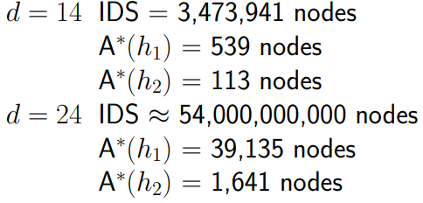
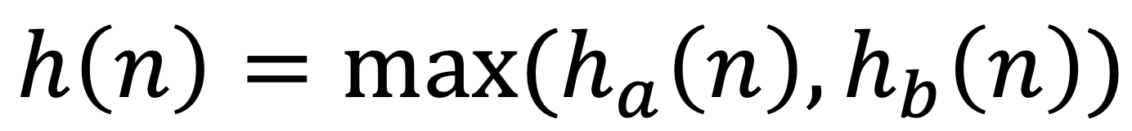
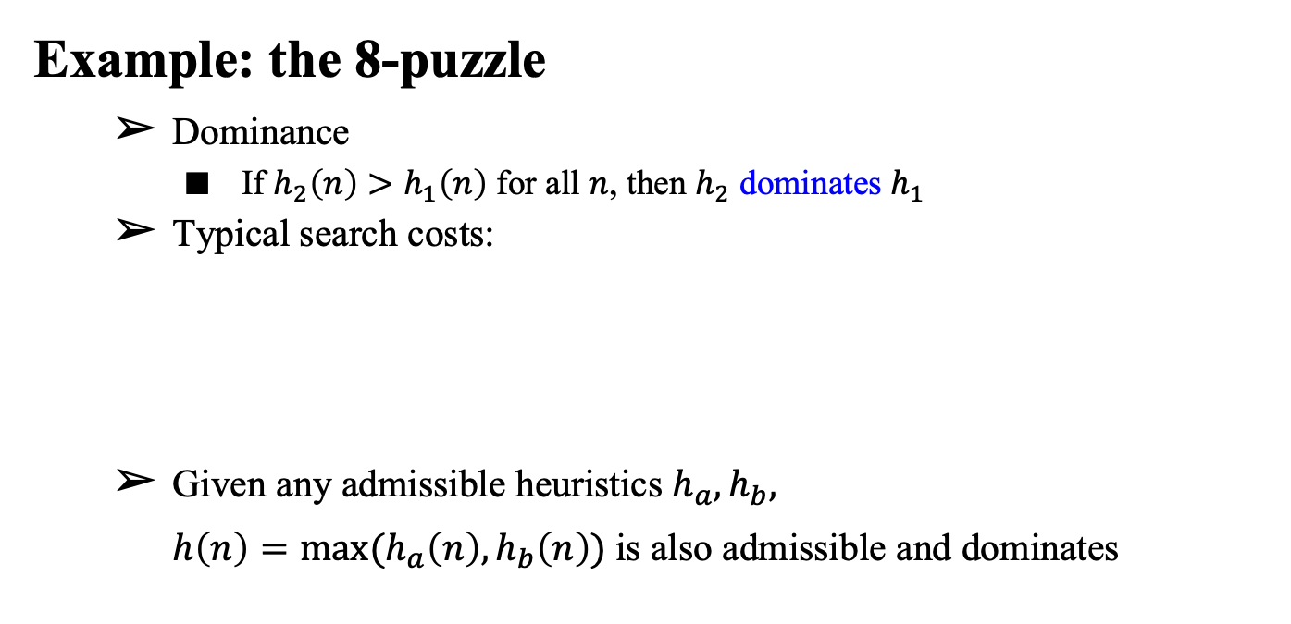
3.6 Heuristic Functions (2/3)
Example: the 8-puzzle
Dominance
If $h_{2}\left(n\right)>h_{1}\left(n\right)$ for all $n$, then $h_{2}$ dominates $h_{1}$
Typical search costs:
Given any admissible heuristics $h_{a},h_{b},$
$h\left(n\right)=max⁡(h_{a}\left(n\right),h_{b}\left(n\right))$is also admissible and dominates

Slide 48
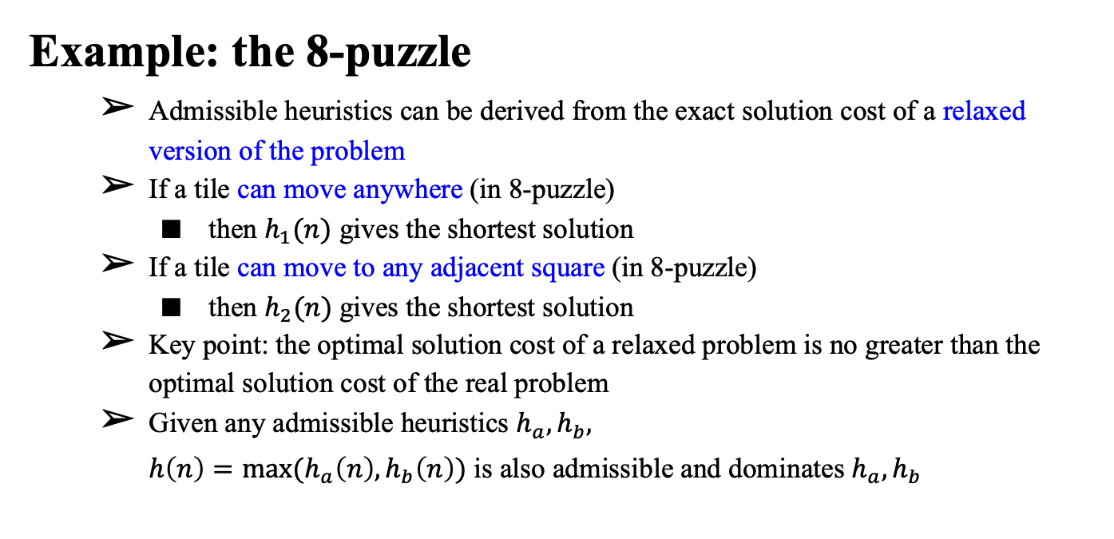
3.6 Heuristic Functions (3/3)
Example: the 8-puzzle
Admissible heuristics can be derived from the exact solution cost of a relaxed version of the problem
If a tile can move anywhere (in 8-puzzle)
then $h_{1}(n)$ gives the shortest solution
If a tile can move to any adjacent square (in 8-puzzle)
then $h_{2}(n)$gives the shortest solution
Key point: the optimal solution cost of a relaxed problem is no greater than the optimal solution cost of the real problem
Given any admissible heuristics $h_{a},h_{b},$
$h\left(n\right)=max⁡(h_{a}\left(n\right),h_{b}\left(n\right))$ is also admissible and dominates $h_{a},h_{b}$

Slide 49
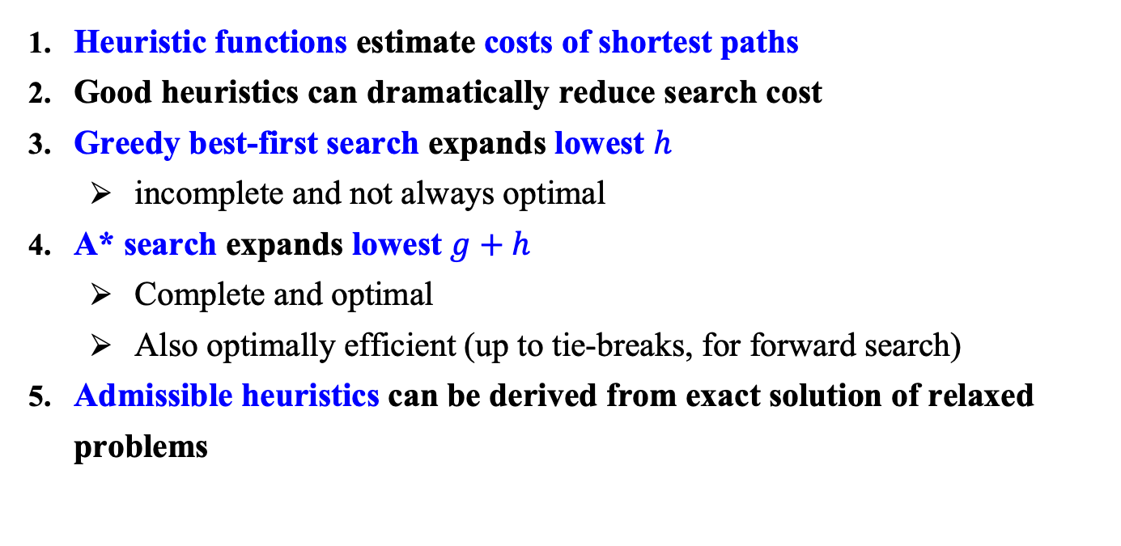
Summary
Heuristic functions estimate costs of shortest paths
Good heuristics can dramatically reduce search cost
Greedy best-first search expands lowest $h$
incomplete and not always optimal
A* search expands lowest $g+h$
Complete and optimal
Also optimally efficient (up to tie-breaks, for forward search)
Admissible heuristics can be derived from exact solution of relaxed problems

